Slide 1


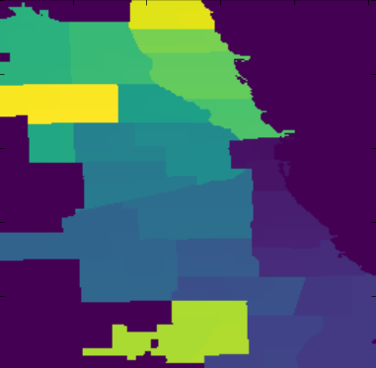
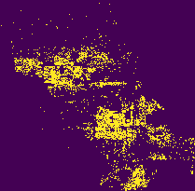
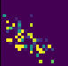
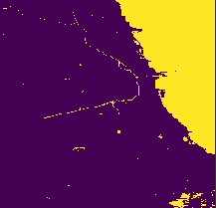
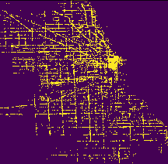
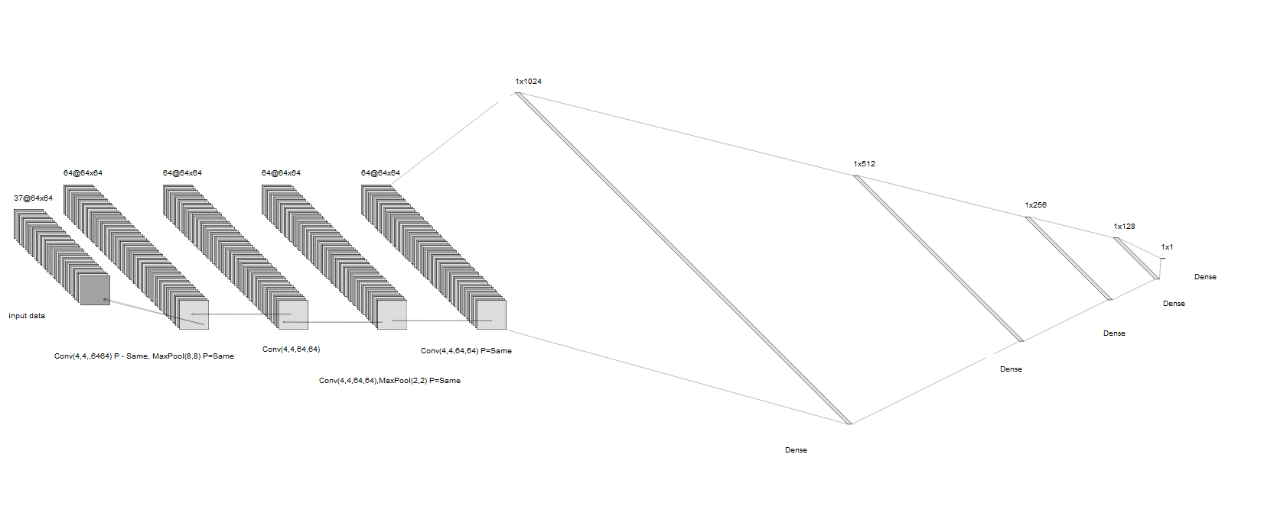
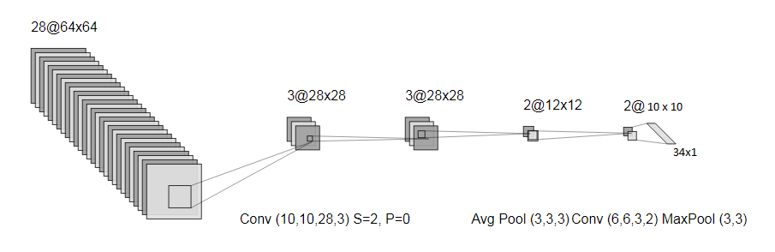
Fighting Crime with Deep Learning
Sean Fitzgerald & Muhammad Ayub
seantom@Stanford.edu ayub786@Stanford.edu
CS 230 Deep Learning -- Project Video https://www.youtube.com/watch?v=Z1KbZEaANmk&feature=youtu.be
Introduction
Methodology
Results
Crime is prevalent in metropolitan areas like Chicago and has a devastating impact on individuals and institutions.
Using deep learning, we hope to predict areas of Chicago with different categories and amounts of crime. We expect that an accurate prediction algorithm could have a positive impact on many aspects of urban life, from policing to city planning.
Realtime Frame Creation Approach
Frames were selected, stacked, and assembled into mini-batches during training. For each mini-batch, we selected random blocks in Chicago, ensuring no pixel overlaps with Dev and Test set data. This method was efficient but utilized significant GPU memory and complicated the training code. Data for this approach was normalized just before training, using a sample mean and variance only.
Full Pre-Rendering Approach
All training examples were rendered beforehand with no compression. This utilized over 300GB of space and took several days of processing. However, it provided fast access to training frames that never changed. This ensured repeatability and increased training speed.
Classification
72% (F₁ = 0.073)
Counting
71%
Problem Statement
Figure 3 shows renderings of a subset of our engineered datasets.
Left operand (input): Chicago police precinct (top left), waterways (bottom left), food service businesses (bottom right), and uninhabitable buildings (top right).
Right operand (output): Crime locations for a location and date (cropped out non-crime part of image). Each pixel is a crime. After training NNs, we engineered the images dataset, and then ran several iterations of CNNs. Our best results are on the far right.
Based on various features of urban life in Chicago from 2001 to today, we plan to build a model that can predict the amount and type of crime that occurs in gridded snapshots throughout the city.
Datasets Assembled For This Project
Public transportation usage
Building structure outlines
Building habitability descriptions
Geographic features:
Waterways, Forests, Streets
Urban features:
School zones, Libraries, Parks
Various socioeconomic indicators (Census)
Chicago's public list of crimes since 2001.
Deliverables
One convolutional neural network capable of predicting a distribution of the primary categories of crime for an area in Chicago at a specific date and time of day.
One hybrid convolutional and fully connected neural network capable of predicting the number of crimes which will occur during a 2-hour time window on a city block in Chicago on a specific date.
A series of rendered GIS and non-location dependent Chicago-based datasets collected from multiple resources and ready for future research
Architectures
A SVN and deep NN was used to baseline our data and verify our assumption that crime can be predicted before attempting more complex models.
Conclusion
Data Engineering
Crime is highly predictable. During phone interviews conducted for this research project, both a New York City Police officer and District of Columbia Metropolitan Police officer stated confidently that intuitive knowledge of a community, including its businesses, layout, and members, can provide enough knowledge to predict and prevent criminal activity. Our research corroborates this, showing that a minimum of 71% of crime in Chicago can be accurately forecast, both in category (sexual assault, theft, narcotics, etc.) and location (precision of about a city block). Our low F1 score is a result of class imbalance. We attempted to solve this, with limited success. Class imbalance remains a challenge for future research with this dataset.
This network performed a regression that quantified the number of crimes committed in a Chicago city block..
Our Data Processing Pipeline
Collect raw data (NOAA, Census Bureau, etc.)
Strip unnecessary information
Convert GIS datasets to Lat/Long
Render GIS data
Build and stack training frames
Input Data Variations
14 feature vector (FC network)
(64 x 64 x 26) (CNN)
(64 x 64 x 95) (CNN)
(64 x 64 x 37) + 58 after CNN (hybrid CNN and FC)
Network Output Variations
Softmax
Regression
Challenges for Future Work
This network performed a classification that predicted the probability distribution of crime categories (35 total) for a given Chicago city block.
Most Common Categories of Crime in Chicago
Many crimes are committed in concentrated areas, causing overlap and thus ambiguous category predictions. Filtering or weighting training examples from sparsely clustered areas might increase classification accuracy.
Criminal activity in Chicago exhibits significant class imbalance. Theft is ten times more common than battery, which similarly more common than criminal damage. This biased our training and could be solved using filtering, likely increasing F1 score.
Datasets describing criminal activity are available from many other cities. Our training set could be augmented by these data. Alternatively, transfer learning could be applied to use our trained networks to predict crime in locations other than Chicago.
Theft
Battery
Criminal Damage
Narcotics
Assault
Burglary
Stec, Alexander, and Diego Klabjan. "Forecasting Crime with Deep Learning.” | Duan, Lian, et al. "Deep Convolutional Neural Networks for Spatiotemporal Crime Prediction.” | Kang, Hyeon-Woo, and Hang-Bong Kang. "Prediction of crime occurrence from multi-modal data using deep learning."

